Slide 1
Week 1 intro to processing
Dr Lewis Evans
Office: E112
Email: L.Evans@mmu.ac.uk

Slide 2
Introductions
Lewis Evans
I’ll be taking you for all of your labs, and I will take over from David from Week 7 onwards for lectures and webinars
Alex Brooke
Post-graduate Teaching Assistant (PGTA) – Part-time PhD and part-time tutor in the department
Peer-Assisted Learners (PALs) – 2nd/3rd year students
Molly – 2nd year Computer Games Development
Phoebe – 2nd year Computer Games Development

Slide 3
Programming
Programming is a 30 credit unit
As a rule of thumb, 1 credit = 10 hours of study
So 30 credits = 300 hours of study dedicated to this unit
Probably the most important unit you will ever study – since it sets the foundation for many of your later units

Slide 4


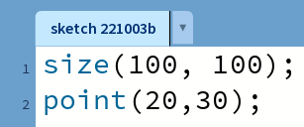

Quick recap on core commands
Point – draws a point (single pixel) at the specified x and y on the screen
Syntax:
point(x, y);

Slide 5
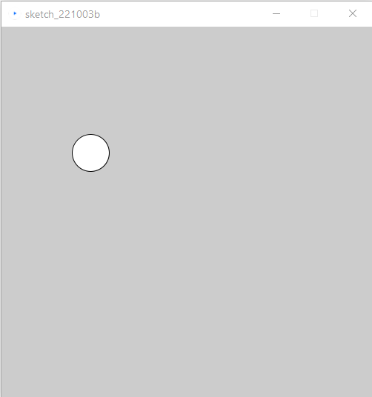

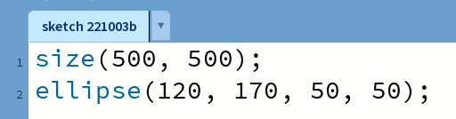
Quick recap on core commands
ellipse – draws an ellipse at the x, y specified, with a specified width and height
An ellipse with an equal width and height is a circle
Syntax:
ellipse(x, y, width, height);
By default, the x and y of an ellipse is the centre

Slide 6
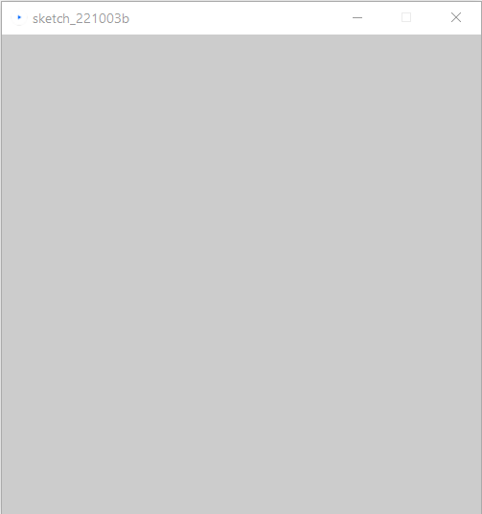
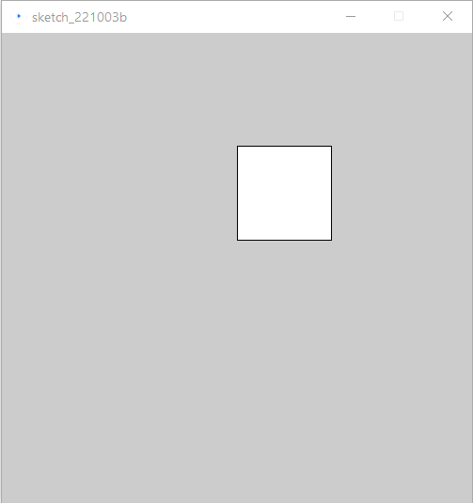
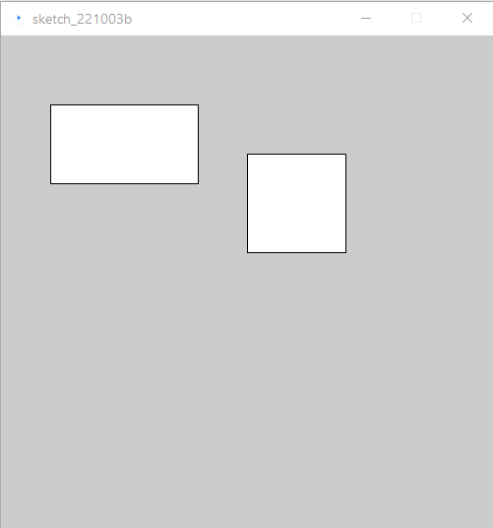
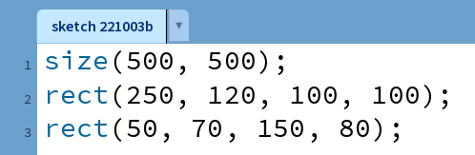
Quick recap on core commands
rect – draws a rectangle at the x, y specified, with a specified width and height
Syntax:
rect(x, y, width, height);

Slide 7
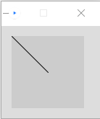
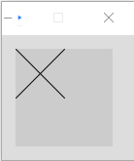

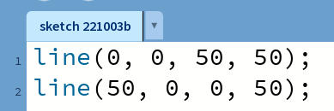

Quick recap on core commands
line – draws a line (connection between two points)
Syntax:
line(startX, startY, endX, endY);

Slide 8
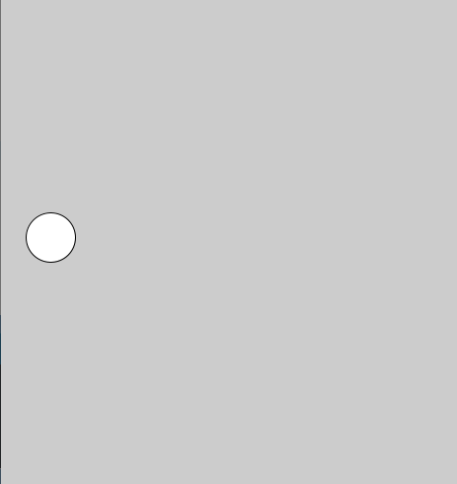
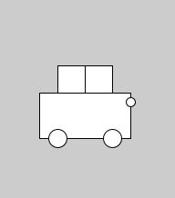

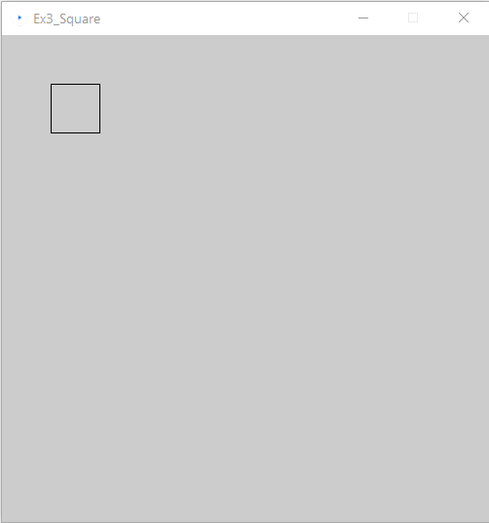

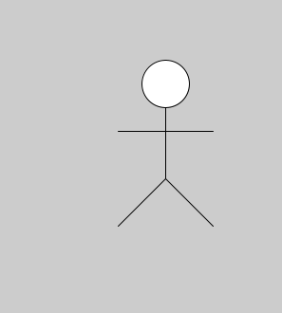
Lab
Exercise 1 - Familiarisation
Exercise 2 – Car (Pair Programming)
Exercise 3 –
Square
Exercise 3b – Movable Square
Exercise 3c –
Scalable Square
Exercise 4 –
Scalable Stick Person

Slide 9
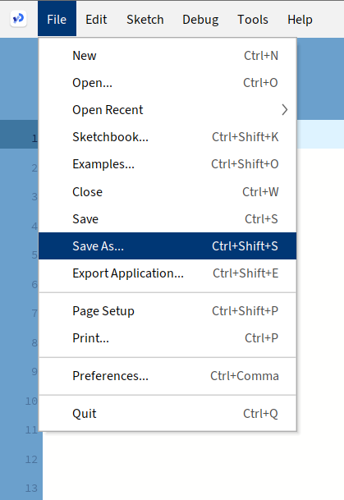
Let’s get started
Open the Lab sheet for this week (Under week 1 on Moodle)
Create a Programming directory on your OneDrive
Create a Week 1 sub-folder – we will save all of our work this week here!
Open up Processing
You should see a new sketch window which is blank
Immediately save the sketch (give it a meaningful name, e.g. Exercise1), and save it in your Programming -> Week 1 directory

Slide 10
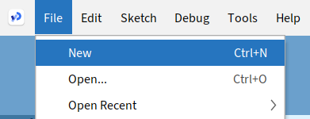
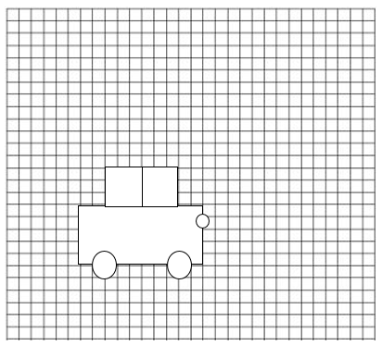
Exercise 2 – Draw a Car
Create a new sketch
In pairs, draw a car similar to the one on this slide
Pair programming involves one person writing the code, while the other makes suggestions. The first coder should get the boxes in the correct places, the 2nd will then take over to get the circles in the correct places
Use the grid to help you, each cell can represent 10 pixels
Your code should be clearly commented to show what each block of commands is drawing

Slide 11

Exercise 3 – Square
Create a new sketch – this will be used for Exercises 3, 3b, and 3c
Draw a square where the length of each side is 50 pixels using only the line command, go clockwise (starting with the top).
Line takes 4 parameters (2 pairs) as follows:
line(startX, startY, endX, endY);

Slide 12
Exercise 3b – Movable Square
Introduce a variable named x to allow the square to be moved left or right on the canvas (hint: you will need to use the x variable in the line commands)
Introduce a variable named y to allow the square to be moved up and down as well

Slide 13
Exercise 3c – Scalable Square
Finally, add a variable called edge that allows you to vary the size of the square and try different values for edge
Alter x and y as well to ensure your square scales and moves depending on the variable values

Slide 14
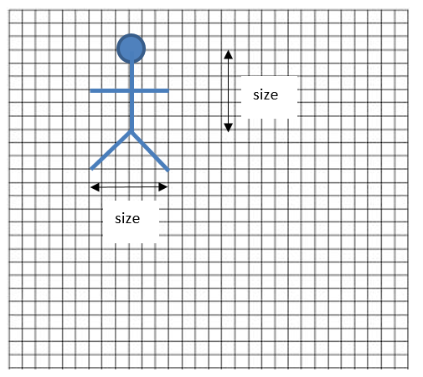
Exercise 4 – Scalable Stick Person
Using the 3 variables x, y, size and only the line and ellipse drawing commands, you must draw a stick person similar to the diagram on the right (with the same relative sizes and positions of each part) where x, y is the centre of the head and the value of size the length of the torso (centre of head down).
Other sizes can be seen by counting the number of graph squares relative to size
You SHOULD add extra variables as required to store suitable starting points for the arms, legs etc.

Slide 15


Thanks!
That’s all for this lab
Feel free to message me (Teams, Discord, Email) if you have any questions
Join Discord if you haven’t! It’s being shared between Computer Architecture, Graduate Skills and Programming this year

